Slide 1
Performance and Troubleshooting Training Agenda
Engaging Performance Engineering
Single User Performance Analysis
Query Tuning
Database Monitoring and Tuning
Troubleshooting Java Applications
Walk-through of some performance/scalability SRs

Slide 2
What to do when you get a performance case…
Chase Harris

Slide 3
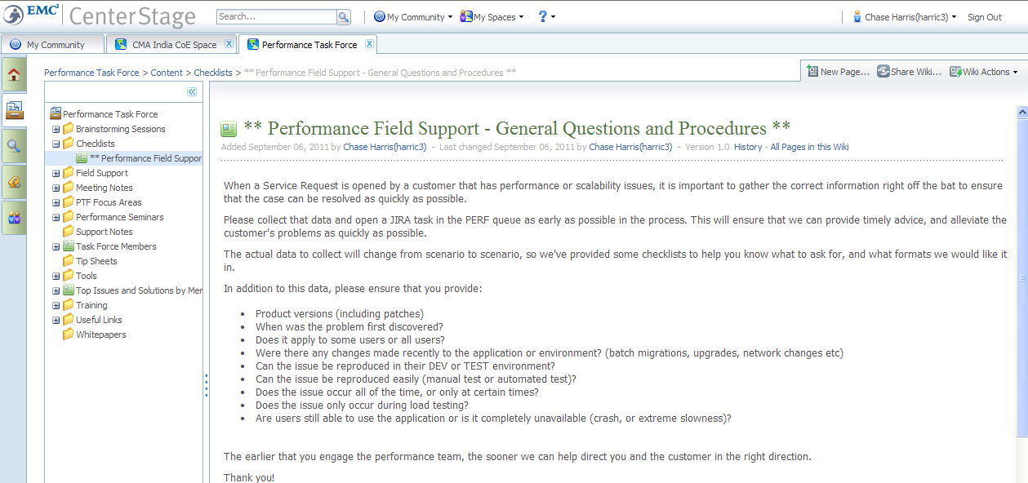
Performance Cases

Slide 4
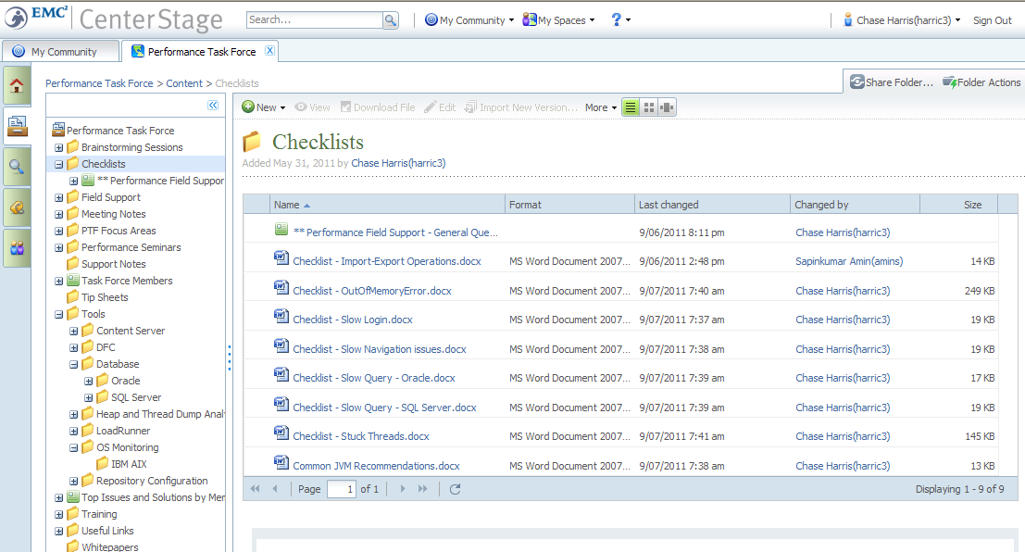
Performance Checklists

Slide 5
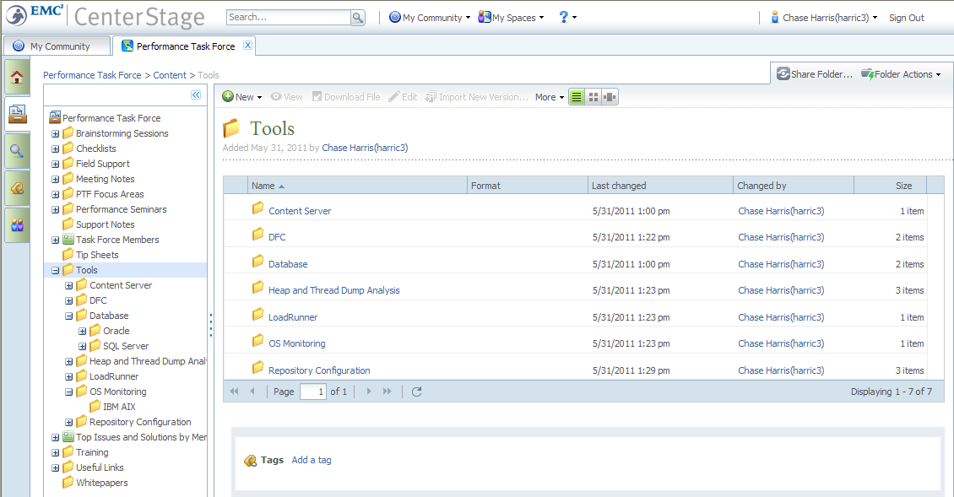
Performance Tools and Utilities

Slide 6
Single User Performance Analysis

Slide 7
Agenda
HTTP request monitoring
Application level monitoring
Network level monitoring

Slide 8
What Factors Affect Response Time
The first step in application performance analysis is ensuring that single-user performance is acceptable.
%!&
2
1
Content Server & Database
Application Server
3
If it is not, where do you look?
Notes:
Before we begin, let’s talk about WHY we need DFC tracing when diagnosing a performance issue.
Performance problems can be introduced at many layers.
When a user sends a request from their browser to the application server, DFC running on the application server communicates to the content server, which then passes the request on to the database back end. Once all of the DFC requests have completed and the page has been generated, the response is sent back to the client machine.
The communication between the application server and the content server is a remote procedure call, or RPC.
The total response time is made up of the time taken to send the request, perform all of the RPCs and application server logic, and return the response to the user.
We can break the response time down to the time spent communicating with the content server, and time spent on the application server by using DFC tracing.
If we see that there is relatively little time spent performing RPCs between the application server and the content server, then we know that the performance issues are on the application server side, or perhaps between the application server and the browser.
If we see that there is a large portion of the overall time spent performing RPCs, then we know that there are either some slow RPCs that need investigation, such as a slow query, or excessive amounts of RPCs, such as unneeded object fetches.

Slide 9
The Performance Toolbox
Measurement can be high-level or extremely granular
HTTP Requests
Fiddler
HTTP Access Logs
Application Level
DFC tracing
RPCs
Overall DFC activity
WDK
UCF
Network Level
Wireshark

Slide 10
HTTP Request Monitoring
Response latency
How much time is spent on the server processing the JSP/servlet request?
Response duration
How long does it take to download the page to the client machine?
Is it longer than expected based on the size of the page?
Compression
Is compression enabled or is it being suppressed by something?
IE→ Use HTTP 1.1 through proxy
Caching
Are cache-control settings working as defined?
IE→ Use HTTP 1.1 through proxy
Web proxy/load balancer stripping the headers?

Slide 11
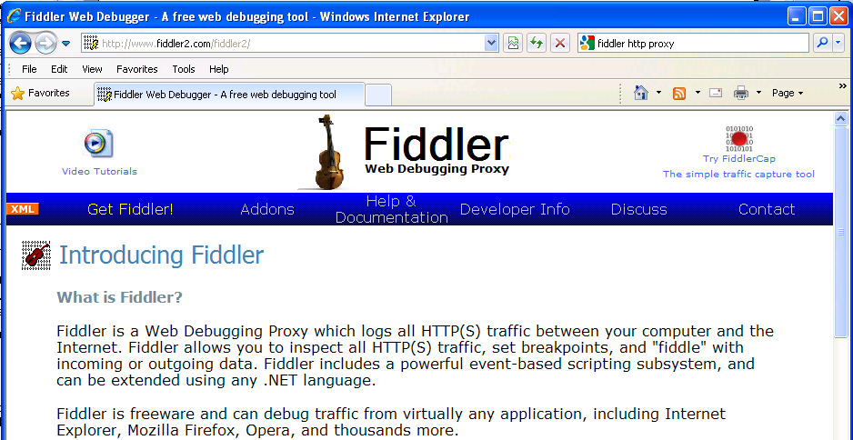
Fiddler Web Debugging Proxy
A free web debugging proxy with additional plug-ins
Download from http://www.fiddler2.com

Slide 12
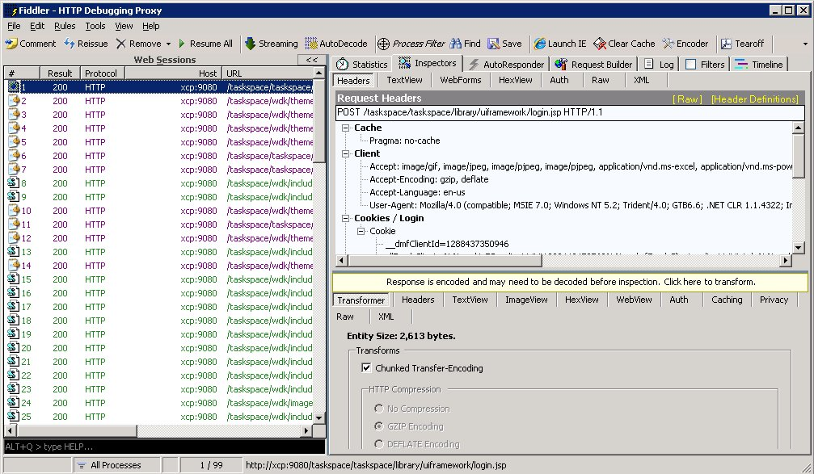
Fiddler HTTP Proxy
Acts as a HTTP proxy to capture requests and responses
Allows you to inspect headers and body for requests and responses
Has capability to “fake” requests for testing

Slide 13
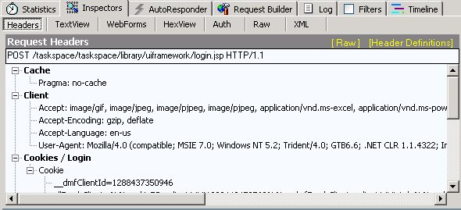
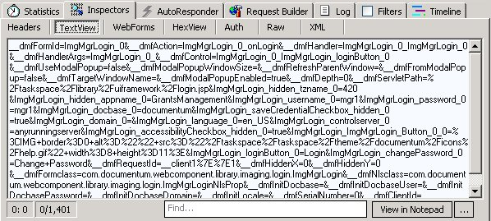
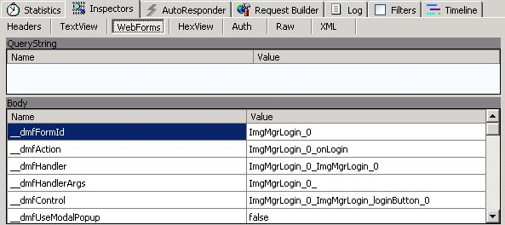
Fiddler – Request Views
View request headers and body as text or in table format

Slide 14
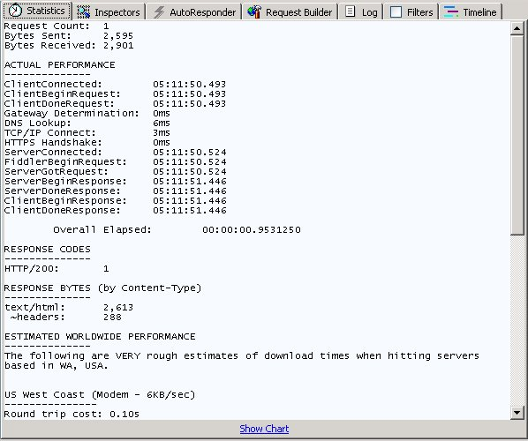
Fiddler – Request Statistics
Provides detailed statistics on how time is spent from click to complete

Slide 15
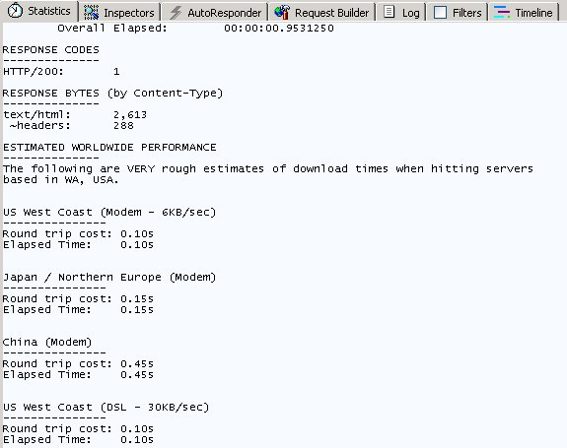
Fiddler – Estimated WAN Performance
Rough estimates on how long individual or groups of requests will take over various WAN conditions
A great sanity check!
Be sure to test cached and uncached

Slide 16
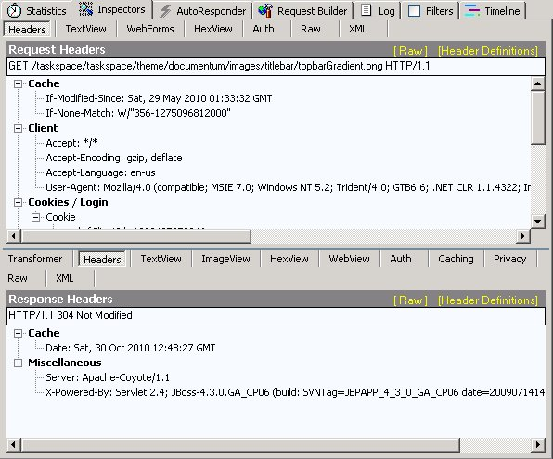
Fiddler – Inspecting Headers
Request and response headers are useful for debugging
Caching issues
Additional cookies needed by UCF invoker due to SSL

Slide 17
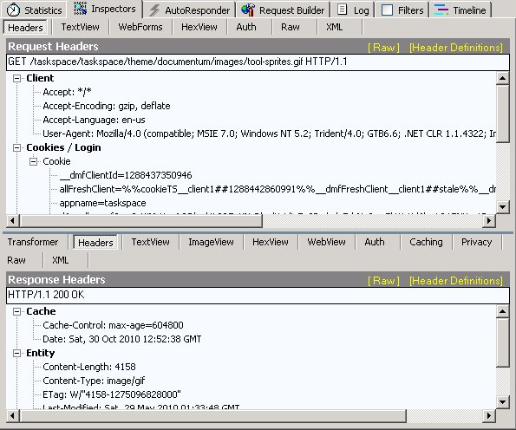
Fiddler – Inspecting Headers (ctd)
If WDK caching is working correctly, you should see “Cache-Control: max-age” in the responses for static objects
If the headers are missing, there is either a misconfiguration in WDK, or a proxy server between the client and the application server that strips them out

Slide 18
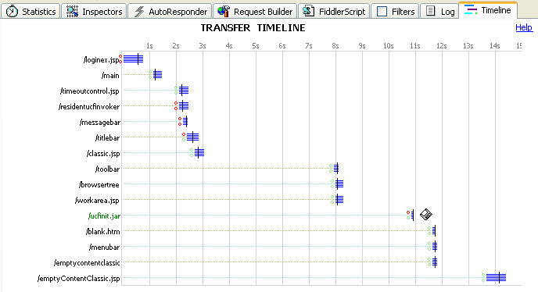
Timeline View – Login Operation

Slide 19
HTTP Access Logs
Response Code # Bytes Time in msec
192.168.10.20 - - [30/Oct/2010:04:39:24 -0700] 'GET /taskspace/wdk/theme/documentum/images/modal/contentsheet_bg.gif HTTP/1.1' 200 5735 0
192.168.10.20 - - [30/Oct/2010:04:39:24 -0700] 'GET /taskspace/taskspace/theme/documentum/images/button/taskspace_buttons.png HTTP/1.1' 304 - 0
192.168.10.20 - - [30/Oct/2010:04:39:36 -0700] 'GET /taskspace/?appname=GrantsManagement&__dmfClientId=1288437350946 HTTP/1.1' 200 396 16
192.168.10.20 - - [30/Oct/2010:04:39:36 -0700] 'GET /taskspace/index.js HTTP/1.1' 200 1657 0
192.168.10.20 - - [30/Oct/2010:04:39:36 -0700] 'GET /taskspace/wdk/redirect.jsp?ReLoad=1288438756243&__dmfUrl=/taskspace/component/main/%3Fappname%3DGrantsManagement%26__dmfClientId%3D1288437350946%26 HTTP/1.1' 200 361 16
192.168.10.20 - - [30/Oct/2010:04:39:37 -0700] 'GET /taskspace/component/main/?appname=GrantsManagement&__dmfClientId=1288437350946&&__dmfTzoff=420 HTTP/1.1' 200 5459 516
192.168.10.20 - - [30/Oct/2010:04:39:37 -0700] 'GET /taskspace/wdk/include/keepFresh.js HTTP/1.1' 200 783 0
192.168.10.20 - - [30/Oct/2010:04:39:38 -0700] 'GET /taskspace/taskspace/theme/documentum/images/logo/department_of_grants_banner.png HTTP/1.1' 304 - 0
127.0.0.1 - - [30/Oct/2010:04:40:29 -0700] 'POST /taskspace/wdk/dummyInlineRefresh.jsp HTTP/1.1' 200 39 15
192.168.10.20 - - [30/Oct/2010:04:42:52 -0700] 'POST /taskspace/taskspace/library/uiframework/login.jsp HTTP/1.1' 200 2600 766
192.168.10.20 - - [30/Oct/2010:04:42:52 -0700] 'GET /taskspace/wdk/timeoutcontrol.jsp?__dmfFrameId=UIFrameworkContainer_timeoutcontrol_grants_manager_0&Reload=1288438972396&__dmfFrameId=UIFrameworkContainer_timeoutcontrol_0&__dmfClientId=1288437350946 HTTP/1.1' 200 200 32
192.168.10.20 - - [30/Oct/2010:04:42:53 -0700] 'GET /taskspace/component/topbarcontrols?__dmfFrameId=UIFrameworkContainer_topbar_grants_manager_0&Reload=1288438972396&__dmfFrameId=UIFrameworkContainer_topbar_0&__dmfClientId=1288437350946 HTTP/1.1' 200 3228 234
192.168.10.20 - - [30/Oct/2010:04:42:53 -0700] 'GET /taskspace/component/taskspacecontent?__dmfFrameId=UIFrameworkContainer_workarea_grants_manager_0&parentFrameId=UIFrameworkContainer_workarea_grants_manager_0&__dmfRefreshFrame=false&Reload=1288438972396&__dmfFrameId=UIFrameworkContainer_workarea_0&__dmfClientId=1288437350946 HTTP/1.1' 200 1029 219
192.168.10.20 - - [30/Oct/2010:04:42:53 -0700] 'GET /taskspace/component/messagebar?__dmfFrameId=UIFrameworkContainer_messagebar_grants_manager_0&Reload=1288438972396&__dmfFrameId=UIFrameworkContainer_messagebar_0&__dmfClientId=1288437350946 HTTP/1.1' 200 2392 203
192.168.10.20 - - [30/Oct/2010:04:42:53 -0700] 'GET /taskspace/component/imgmgrnav?__dmfFrameId=UIFrameworkContainer_navigation_grants_manager_0&Reload=1288438972396&__dmfFrameId=UIFrameworkContainer_navigation_0&__dmfClientId=1288437350946 HTTP/1.1' 200 3442 188
192.168.10.20 - - [30/Oct/2010:04:42:55 -0700] 'GET /taskspace/taskspace/theme/documentum/images/titlebar/topbarGradient.png HTTP/1.1' 304 - 0
HTTP Response Codes 200 – Success 304 – Not modified 500 – Error
Notes:
To enable response time logging in BEA:
In the weblogic console, open the server that you are working with and choose Logging > HTTP.
Click on the "HTTP access log file enabled" to turn it on.
At the bottom, click on "Advanced"
Change the format to "Extended"
Add "time-taken" to the end of the format string.
Save your changes and restart the server.

Slide 20
Enabling Extended HTTP Access Logging
Tomcat/Jboss – server.xml
<Valve className="org.apache.catalina.valves.AccessLogValve“ prefix="localhost_access_log." suffix=".log“ pattern="%h %l %u %t '%r' %s %b %D“ directory="${jboss.server.home.dir}/log” resolveHosts="false" />
Weblogic:
In the weblogic console, open the server that you are working with and choose Logging > HTTP
Click on the "HTTP access log file enabled" to turn it on
At the bottom, click on "Advanced“
Change the format to "Extended“
Add "time-taken" to the end of the format string
Save your changes and restart the server

Slide 21
Summary of HTTP Request Analysis
Fiddler
HTTP Access Logging

Slide 22
Application Level Performance Measurement
DFC Traces provide valuable low-level data about client- and server-side performance issues
Best practices
Record DFC traces on a quiet system if possible
Start with RPC traces to search for low-hanging fruit
Limit recordings to single “clicks”
Prime the cache
The first click caches many different objects and query values
Form template configuration
Workflow and task information
SDT and process variable parent definition and object values
Package information
Preset information
First click is important if the performance on the FIRST access is deemed unacceptable, but second is OK

Slide 23
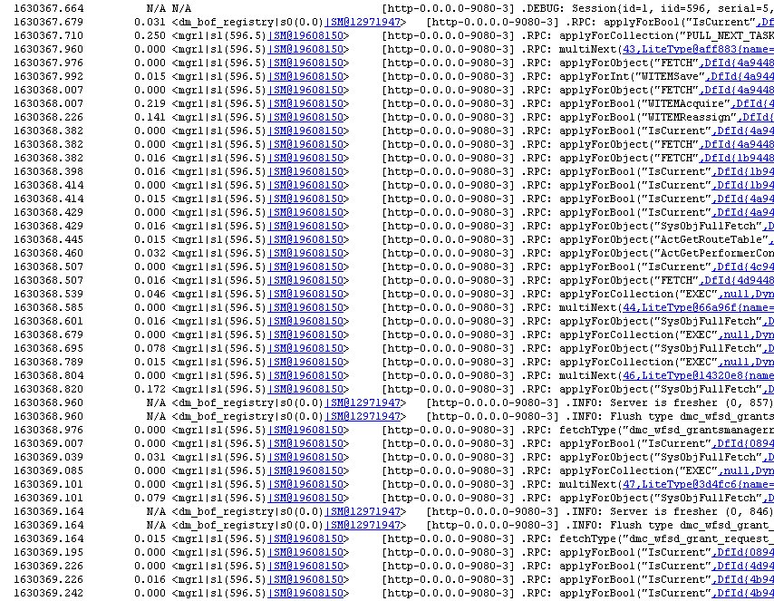
DFC Tracing – RPC Performance
Notes:
When DFC tracing is enabled to capture RPC information, a file similar to this will be generated on the application server.
The first column is a timestamp, showing the number of seconds since application server startup.
The second column shows the time in seconds spent executing the RPC.
Then we see the information about the user and session executing the RPC, followed by the application server thread performing the work.
Finally, we see the actual RPC call itself, along with any arguments passed to the content server.
Some RPC calls are queries, such as the ones marked applyForCollection(“EXEC”). Fetching the resulting rows in batches from the collection is done using the MultiNext RPC.
Others are more directed RPC requests which perform one or more operations on the content server and database. Examples are “applyForObject” or “fetchType”.
Understanding how each of these RPCs perform, and how often they are performed, involves analyzing the trace.
Trace files can be very large, so eyeballing it can be very difficult and timeconsuming.
Today we’ll see how to quickly parse the trace file and capture the important information so you can more quickly get to the root cause of the performance problem.

Slide 24
Enabling RPC Tracing
Enable in dfc.properties:
dfc.tracing.enable=true
dfc.tracing.verbose=true
dfc.tracing.max_stack_depth=0
dfc.tracing.include_rpcs=true
dfc.tracing.mode=compact
dfc.tracing.include_session_id=true
dfc.tracing.dir=c\:/temp/trace
dfc.tracing.file_prefix=dfctrace
Analyze with awk scripts:
trace_rpc_histD65.awk (https://community.emc.com/docs/DOC-11943)
traceD6.awk (https://community.emc.com/docs/DOC-1218)
Example:
awk –f trace_rpc_histD65.awk < dfctracefile > outputfile
Notes:
DFC tracing is enabled in the dfc.properties file for the application.
When you want to gather DFC traces to capture RPC information, it is important use the following settings.
Dfc.tracing.enable=true turns on the tracing. It is not necessary to restart the server, as DFC periodically checks this file for changes.
Dfc.tracing.verbose=true tells DFC to add extra information to the trace, such as the object id that the RPC is making the request for.
Dfc.tracing.max_stack_depth=0 tells DFC how deep in the call stack it should report. As we are capturing RPC information only, it should be set to 0.
Dfc.tracing.include_rpcs=true instructs DFC to include RPC calls in the trace file.
Dfc.tracing.mode=compact will have one line per operation, as opposed to dfc.tracing.mode=standard, which will show the entry and exit for each request.
Dfc.tracing.include_session_id=true is important so that we can track which session issued which request, as there may be multiple sessions for a single user.
Dfc.tracing.dir allows us to specify the location of the trace file, and dfc.tracing.file_prefix will prepend a string to the trace file name, which makes it easier to find and label exactly what the trace is for.
Once these have been added to the dfc.properties file and saved, and DFC has detected the changes, a trace file will be created in c:\temp\trace, with a prefix of dfctrace.
You can then perform the operation that you want to capture, and turn off tracing by setting dfc.tracing.enable back to false and saving dfc.properties again.
Once you have a trace file, the next step is to run it through the parse analyzer script.
On the EMC Developer Network you can download the scripts we use internally to do RPC trace analysis.
Trace_rpc_histD65.awk analyzes the trace file, producing information about pauses in processing, RPC statistics and query timings.
TraceD6.awk compresses the trace file and formats it in such a way that it can be imported into a spreadsheet for further analysis.
Both scripts are written in “awk” which is available on all Unix systems. On Windows, you can use dm_awk (which is provided as part of the content server install), or install free versions, such as the one included with Cygwin.
The syntax to execute the parse is shown here. It will only work if you have used the dfc.properties settings shown above. Other formats will result in a blank output file.

Slide 25
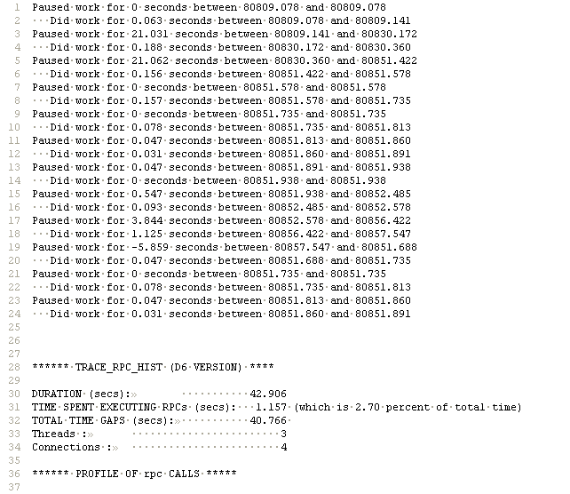
trace_rpc_histD65.awk Output
Long pauses between RPC activity indicates some sort of activity on the client (or app server)
High percentage of RPC time indicates problem is on the server. Low percentage points to the client. ** single-click traces only
Notes:
So, let’s look at the output.
At the top of the output file, it breaks down the total time into time spent working, and time when the program is idle.
This is useful if you want to see if the full time is being spent on the application server doing work, or a lot of the time is spent waiting for outside activity, such as browser rendering.
Please note that this data is only useful if the trace contains the activity for a single user, and not from a busy production system.
If you see pauses that you don’t expect, then further investigation is warranted.
The next section summarizes the entire session, including the duration of the trace, how much time was spent executing RPCs, and the total length of gaps during the session.
In single-click traces, if you see that a high percentage of the time is spent processing RPCs, then it is likely that there are poorly performing RPCs that require closer inspection.
However, if you see that the total RPC time is small, and the total time gaps are long, then most of the time is likely spent doing processing on the application server, or rendering on the browser client.
In this case, the total RPC time is quite short.
Let’s see which RPCs were executed and get an idea of how they performed.

Slide 26
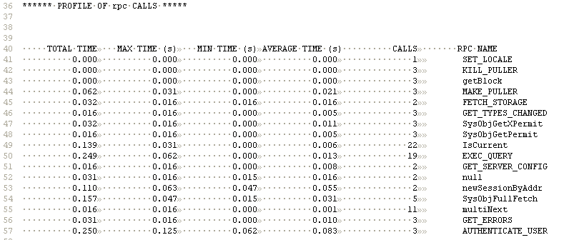
RPC Summary
Notes:
The next section profiles all of the RPC calls that were identified in the trace.
We see the total time spent processing all executions of that particular RPC.
We can also see the minimum, maximum, average and counts for each RPC call.
Prior versions of the tool only showed the average, which was sometimes misleading and could mask individual instances of the RPC call that were taking significantly longer to execute.
In addition to the response times though, it is also important to look at the counts to see whether there are a large number of fetches, which may indicate inefficiency in the program.
In many cases, it is the EXEC_QUERY RPC that is the most expensive, and quite often the easiest RPC to tune.
The next section will list all of the DQL queries executed during the trace, ordered by time, so you can get more details about what was actually executed.

Slide 27
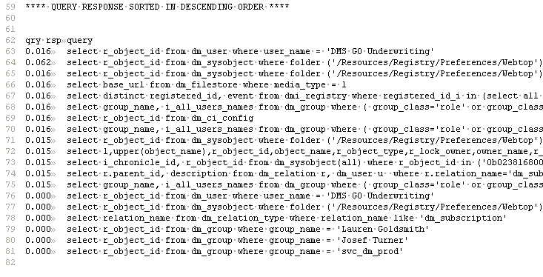
Query Summary
Tip:
Import the queries into MS Excel to sort by query and find out if a certain query is being executed more than necessary
Notes:
So, here we see the breakdown of all of the queries.
They are sorted by response time to allow you to very quickly identify which ones are candidates for query tuning.
I often find it useful to import those queries into Excel and sort them to count how many times a particular query is executed.
For example, you can see that the preferences query at the top is executed four times in this trace.
Multiple executions of a query can often be very costly and should be investigated if it is contributing to the overall response time of an operation.

Slide 28
Things to Look For
Long running queries
Lots of quick queries
Repeated queries
Large number of fetches/currency checks
Slow session creation
Slow authentication
Pauses in application activity
Errors and Exceptions
Notes:
So, in summary, you will use RPC traces to look for:
Long running queries
Lots of quick queries
Repeated queries
Large number of fetches/currency checks
Slow session creation
Slow authentication
Pauses in application activity
Errors and Exceptions

Slide 29
DFC Tracing – Overall DFC Activity
Useful to identify the complete set of requests/tasks performed during an operation
Local vs. remote processing time
Breakdown to lowest level
dfc.tracing.enable = true dfc.logging.verbose = true dfc.tracing.include_rpcs = true dfc.tracing.include_session_id = true dfc.tracing.log.level = DEBUG dfc.tracing.max_stack_depth = 20 dfc.tracing.timing_style = date dfc.tracing.verbose = true dfc.tracing.date_column_width=12 dfc.tracing.date_format=yyyy-MM-dd hh:mm:ss.SSS # dfc.tracing.mode=standard dfc.tracing.max_file_size = 100MB dfc.tracing.max_backup_index = 30 dfc.tracing.dir=c:/temp dfc.tracing.prefix=dfctrace
WARNING: very verbose!
Notes:
An alternate way to collect application performance information is by enabling full DFC tracing.
This is especially useful in the case where an RPC trace shows no slow RPCs, and some non-RPC activity is suspected as the root cause.
To enable full DFC tracing, you can use these settings.
Now, be warned, full DFC tracing should only be enabled for a very short time, ideally one click only, on a system that is not being used by other users. The amount of information logged is significant, and trace files can easily be more than 100MB.
Let’s have a look at the output.

Slide 30
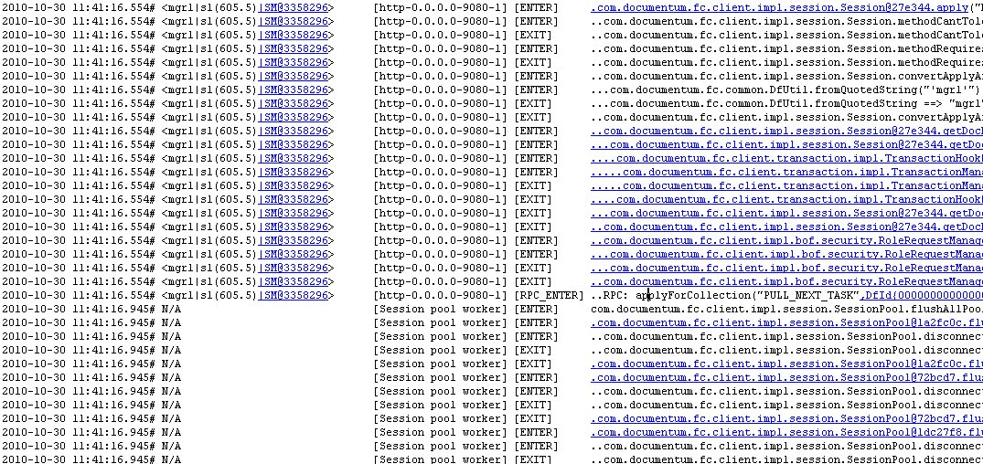
Full DFC Tracing Output
Notes:
The log shows the entry point and exit of each DFC call.
RPC calls are marked with the “RPC_ENTER” tag to differentiate them from client-side requests.
The dots to the left of the method name indicate its level in the call stack.
When the ENTER is not immediately followed by the EXIT, it indicates that there are sub-requests as part of the higher level request.
Now, as you can see, this can be quite difficult to analyze as it is.

Slide 31
Analysis Method
Use awk to get “level 0” ENTER and EXIT
Identify slowest high level action (use MSExcel)
Copy full trace data for that component and drill down
/\[ENTER\] com/ {
stime=substr($2,0,length($2) - 1);
call=$6;
}
/\[EXIT\] com/ {
etime=substr($2,0,length($2) - 1);
print stime " " etime " " call;
}
Notes:
One way to analyze the full DFC trace is to use awk to parse it to find the slowest top-level call.
The pattern searches for the ENTER message followed by a number of spaces, followed by com. As there are no periods before com, we know that it is the top level in the call stack.
It captures the start time, and the call made.
It then looks for the corresponding EXIT message, and captures the end time.
Finally, it prints the start time, endtime and request.
This information could then be imported into Excel and analyzed to identify the timestamps for the longest running high-level request.
Copy the range of DFC calls between the start and end times from the full DFC trace file to a new file.
Now you’ll have a smaller set of data to analyze, and can drill down to see where the time is being spent.
There’s no magic awk script to parse and analyze this format of DFC trace, but this technique allows you to focus on a smaller set of data, and will hopefully make it easier to identify the root cause of a non-RPC performance issue.

Slide 32
Additional Tips
Don’t restrict tracing to a single user if possible
When tracing multiple operations, separate them into different trace files for ease of analysis
Set the prefix for the first operation
dfc.tracing.file_prefix=click1
Change the prefix for the second operation and wait until file appears
dfc.tracing.file_prefix=click2
Disable tracing after last operation
dfc.tracing.enable = false
Sometimes the trace will contain long binary strings that prevent parsing from working
Delete them manually as they are not important during analysis
If “awk” fails to work, try “gawk”
Install Cygwin on the analysis machine to use useful commands like awk, gawk, grep, sort, uniq, head and tail
Notes:
Finally, here are a few tips to make tracing and analysis easier.
Firstly, although DFC allows you to limit the tracing to a specific username, it will not record the supporting operations performed by the system accounts, like dm_bof_registry, which might also be contributing significant time to the operation.
If you want to record RPC or DFC traces for multiple operations in one testing session, the easiest way is to specify a prefix for the trace file, and change the prefix after each click. Because DFC checks the dfc.properties file for changes frequently, it will pick up the new prefix and start writing to the new file.
If you have difficulty parsing the DFC trace, and awk reports that the file is binary, you will need to go into the file, find the binary data and delete those lines. They are not important for performance analysis, and once deleted the trace file will parse correctly.
Trace files can be traced using most variants of awk, so if your version is not working, try another variant. The free software package Cygwin can be installed on Windows machines to provide awk, gawk and other useful utilities helpful when analyzing DFC traces.

Slide 33
UCF Client Logging
%USERPROFILE%\Documentum\ucf-java\ <SERVERNAME>\shared\config\ucf.client.logging.properties
.level=FINEST
java.util.logging.FileHandler.pattern=C:/Documentum/logs/ucf.client%u.log
java.util.logging.FileHandler.limit=10485760
java.util.logging.FileHandler.count=10
Useful to identify:
If ACS is being used
If parallel streaming is enabled
Throughput rates for transfers to different sites

Slide 34
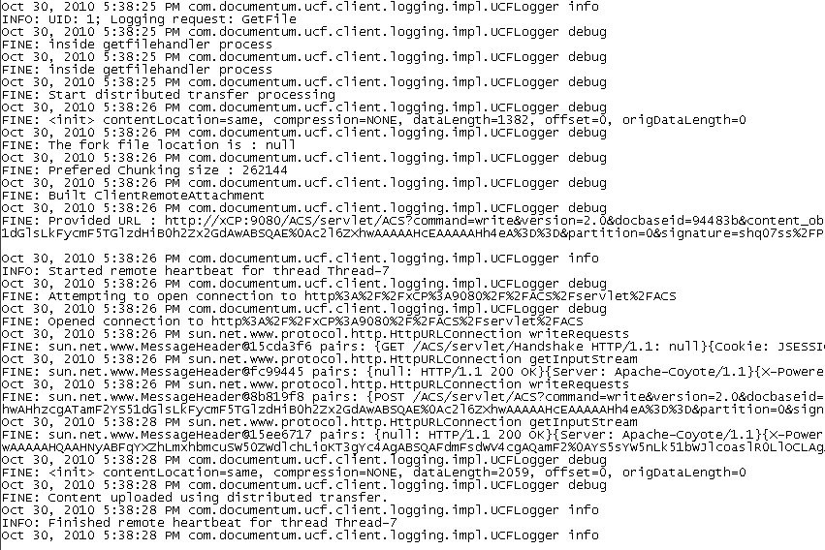
UCF Client Logging

Slide 35
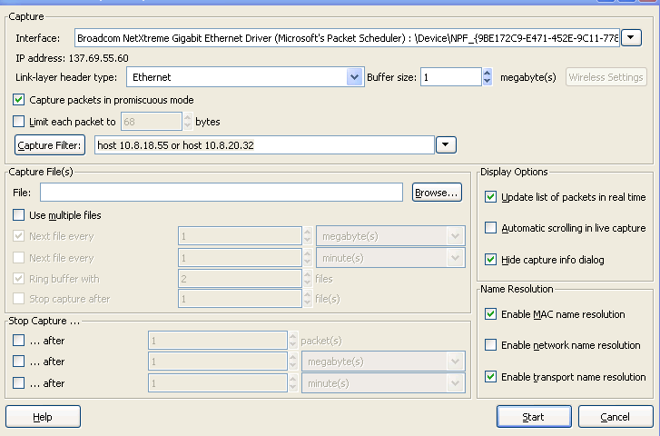
Network Tracing Using Wireshark
Helpful to identify if the issue is related to a network issue or a TCP configuration issue
Some clients’ security policies prohibit the use of sniffers, so ask first!

Slide 36
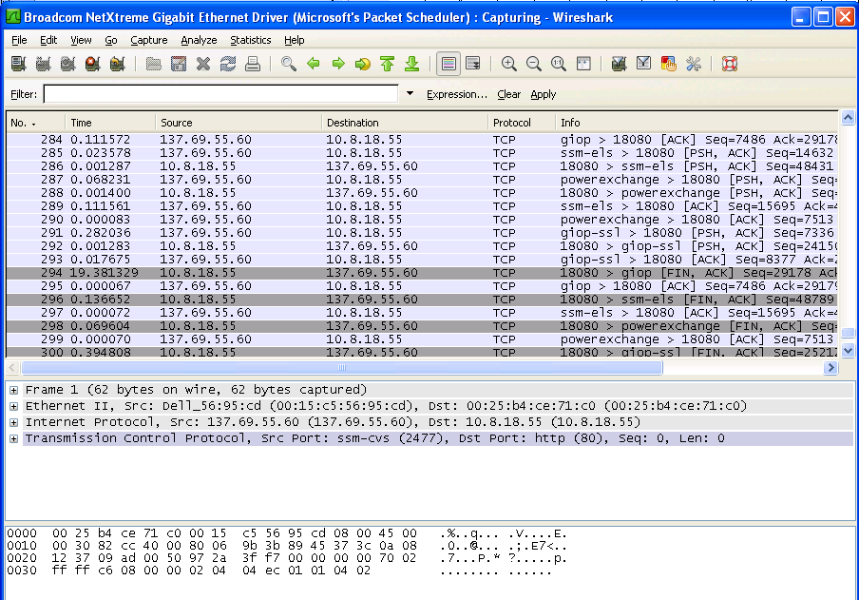
Wireshark Packet Traces
Detailed packet-level information about conversations between machines
Under “Analyze” there are good reports to show the number of packets and bytes transferred in either direction

Slide 37
Recap
HTTP request monitoring
Application level monitoring
Network level monitoring

Slide 38

Q&A

